Slide 1
MS Access
Lab 29: Lookup Table

Slide 2


Welcome to MS Access Class

Slide 3

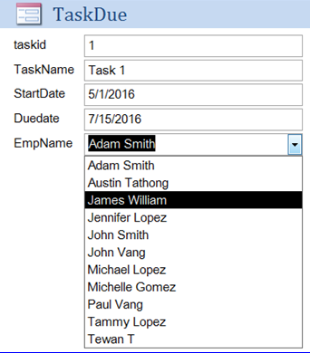
What is lookup Table?
A table that contains data that is referenced by another table. The other table will have a lookup field that can "lookup" the data in the lookup table.

Slide 4
Table
Create a Lookup Table

Slide 5
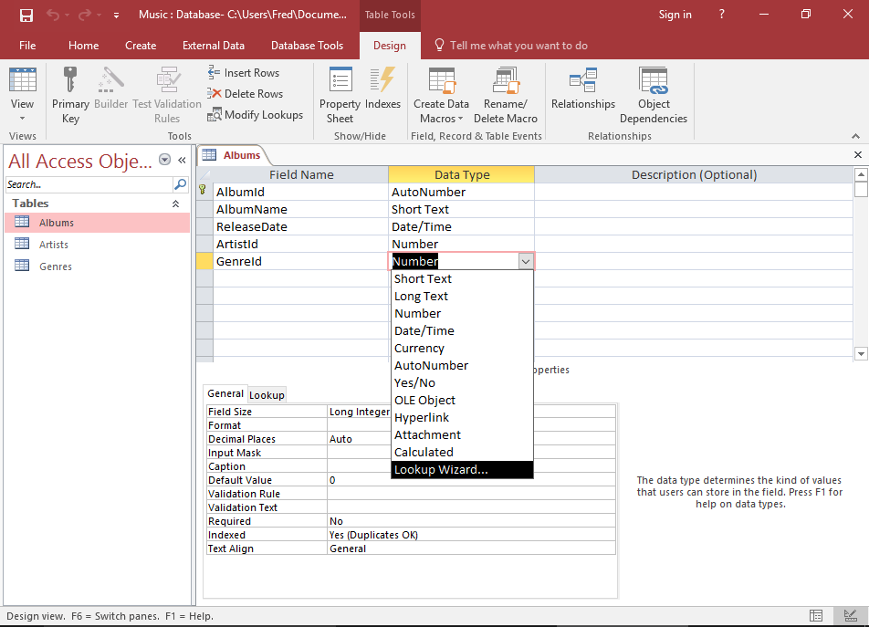
Lookup Table
Launch the Lookup Wizard
Open the Albums table in Design View. In the GenreId field, click in the Data Type cell and select Lookup Wizard from the combo box. The Lookup Wizard will appear.

Slide 6
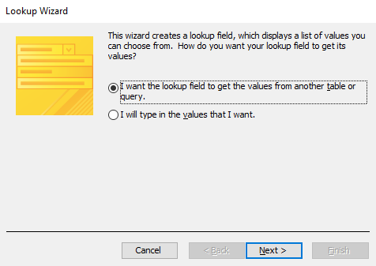
Lookup Table
2. Choose how the Lookup Field will get its Values
Leave the default option (I want the lookup field to get the values from another table or query.) selected and click Next >.

Slide 7
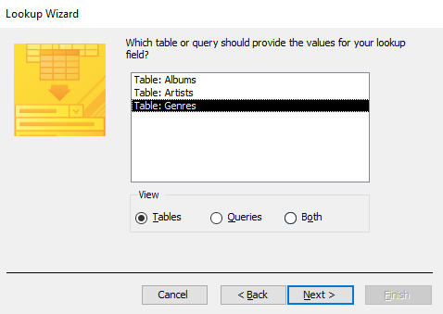
Lookup Table
3. Choose the Lookup Table
Here, you get to choose which table will provide the values for your lookup field. Select Table: Genres and click Next >.

Slide 8
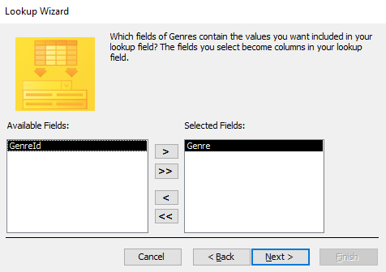
Lookup Table
4. Choose the Field/s to display in the Lookup Field
You can choose which field will be displayed in the lookup field of the table referencing the lookup table. Double-click Genre so that it moves to the right pane, then click Next >.

Slide 9
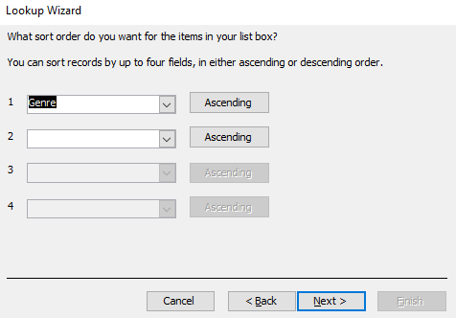
Lookup Table
5. Choose the Sort Order for the Lookup Field
You can choose how the data will be sorted in your lookup field. For this example, we will sort by the Genre field in ascending order. Select Genre from the first drop down, then click Next >.

Slide 10
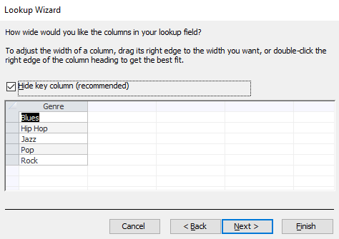
Lookup Table
6. Select the Column Width of the Lookup Field
Access gives you the opportunity to specify the width of the column/s in your lookup field. If our field contained longer values, we might widen it, but the default width looks pretty good. You can also choose to display or hide the lookup table's primary key column. Leave it hidden. Click Next >.

Slide 11
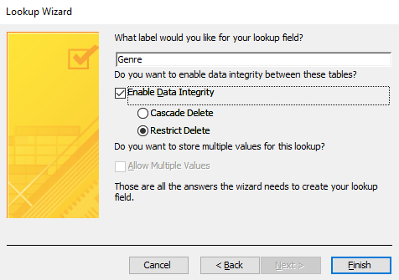
Lookup Table
7. Choose a Label for the Lookup Field
You can provide a label for the lookup field. In our case, let's shorten it to Genre. Also, check Enable Data Integrity. Click Finish to generate the lookup table.

Slide 12
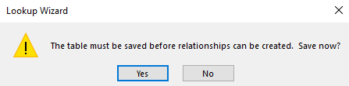
Lookup Table
8. Save the Table
If you get prompted to save the table, click Yes and save it.

Slide 13
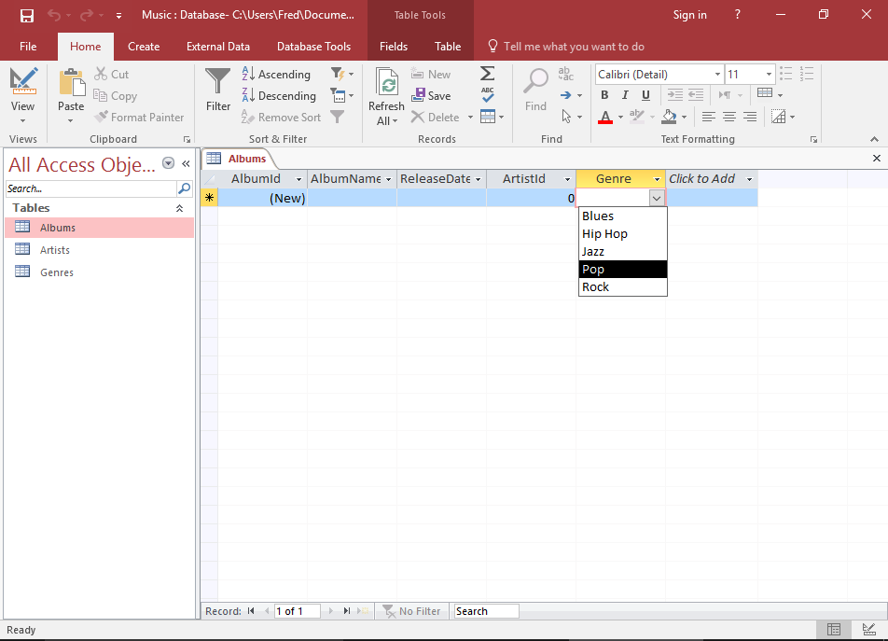
Lookup Table
9. Check your Lookup Field
Your lookup table (and corresponding lookup field) has now been created. Check your lookup field by switching to Datasheet View and clicking in the Genre field.

Slide 14

Thank You!

